Slide 1
Saints Peter and Paul School
Home and School Association
Welcome Parents and School Staff

Slide 2
Opening Prayer
Mrs. Chandler
PRAYER LINK

Slide 3
Agenda
Welcome
Golf Outing Update
Board of Limited Jurisdiction Introduction
School Update
Advancement Office
Home & School Association
Notes:
HSA - Welcome. Introduce mission/purpose of HSA. Cover basics of the school plus 3 topics for evening: Activities/Events, Service, and Fundraising. To give a better sense of how our school is governed, we turn it over to Dan McKinney, Chairperson of the Board of Limited Jurisdiction.

Slide 4
Monsignor Foley Golf Outing
Monday, September 25th at Penn Oaks
12:30 tee off and 5:30 PM dinner
Thank you for your support!!
Join us for cocktails & dinner only - $100 per person
Sponsor a teacher OR teacher table!
Student dress down day 9/25
50/50 raffle, 💎earring raffle & Phillies basket
https://SSPPGolfOuting.givesmart.com

Slide 5
BOLJ Update
Mr. Dan McKinney

Slide 6
Board of Limited Jurisdiction
The board, with limited power of governance and in collaboration with the pastor and principal, is a participatory, policy making body ensuring that the finances of the school remain healthy, and ensures a course of education as prescribed by the Archdiocese of Philadelphia and the applicable policies, rules, and regulations of the Commonwealth of Pennsylvania.
Catholic School Development Program, Est. Sept. 2010 Board of Limited Jurisdiction Operating Principles

Slide 7
Board of Limited Jurisdiction
Committees
Finance | Facilities | Technology | Development | Marketing | Governance
Operating Principles
Board Duties:
Not Board Duties:
Advancement & Strategic Planning
Financial Oversight
Board Development & Evaluation
Principal Selection and Evaluation as it relates to the board
Review of administrative decisions
Personnel issues that concern students, faculty or staff members
School Curriculum
Hiring or Firing

Slide 8
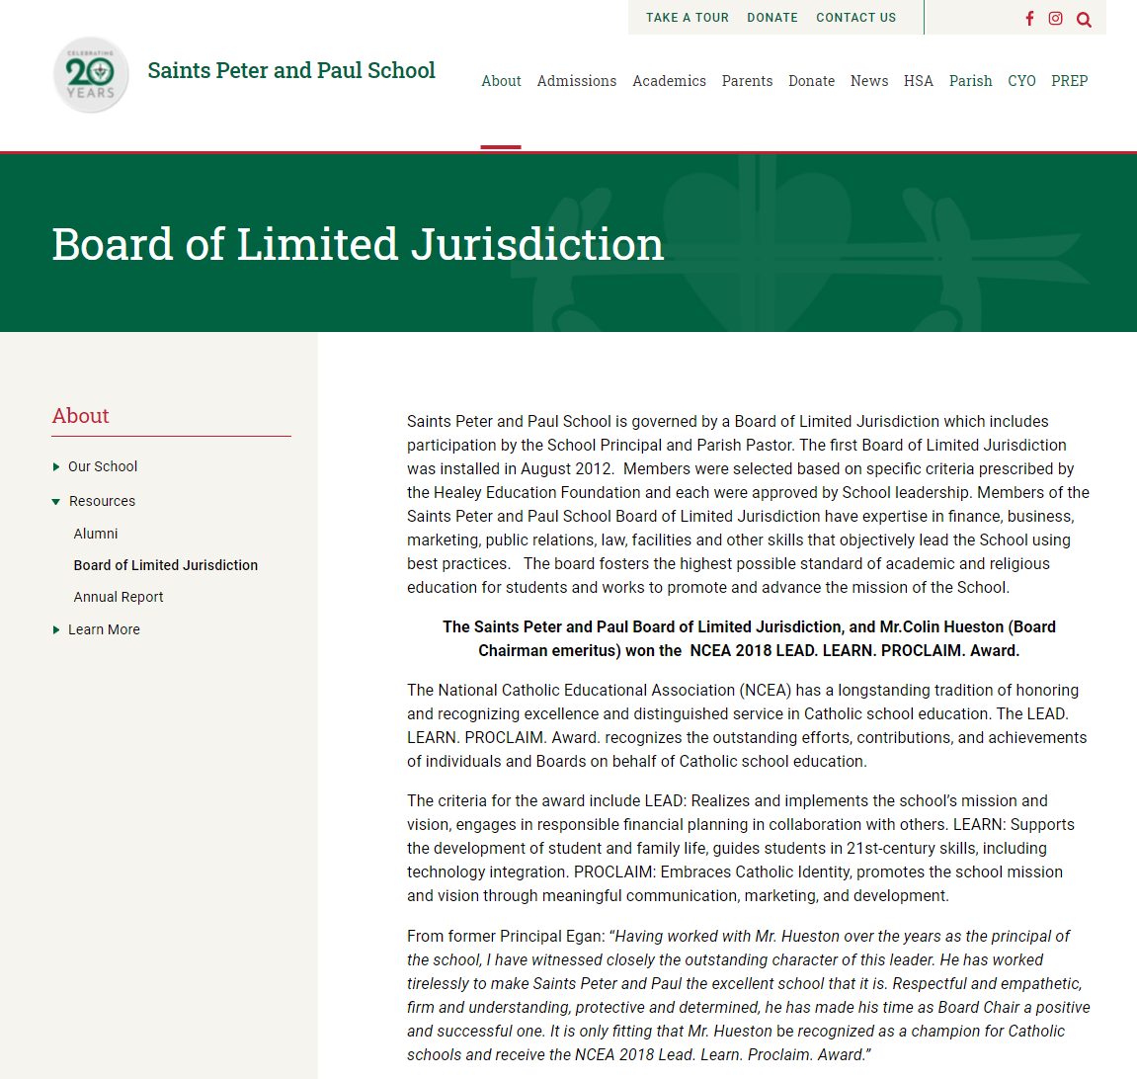
Board of Limited Jurisdiction
School Website
Annual Report

Slide 9
Board of Limited Jurisdiction
Project Updates:
Art & Music Center
Gym Refurbishment
Facilities New Building
Window Security Film
Fire System Update
HVAC Replacement
Field Fence
Driveway Paving

Slide 10
Board of Limited Jurisdiction
Questions / Concerns / Get Involved
Dan McKinney, P ‘21, ‘24 danmckinney@gmail.com (267) 254-5404

Slide 11
School Update
Mrs. Chandler

Slide 12
Advancement Update
Barb McCarron

Slide 13
Advancement Update
Welcome to our 48 new families! Current enrollment PK3-8 is 389
Priority Enrollment for the 2023-24 school year begins November 1. Re-enrollment will also begin November 1
Open Enrollment begins on November 15
Referral Program. Get $500 off of tuition for every verified new family referral
Notes:
CC
he goal of the Annual Fund is for financial independence of the school from the parish (decrease in parish subsidy every year)The goal of the Annual Fund is for financial of the school from the parish (decrease in parish subsidy every year)B

Slide 14
Advancement Update
Day of Giving is November 29th- Funnels directly into the “Together In Faith” Annual Fund. Annual Fund goal is $200,000
Niche Reviews needed. Can be from current parents, alumni parents, and alumni https://www.niche.com/k12/survey/start/?t=k&e=saints-peter-and-paul-school-west-chester-pa
Yard signs available to take home
Crusader Times Update
Notes:
CC
he goal of the Annual Fund is for financial independence of the school from the parish (decrease in parish subsidy every year)The goal of the Annual Fund is for financial of the school from the parish (decrease in parish subsidy every year)B

Slide 15
HSA Update
Regina Holloway, Amy Spencer, Jillian Helmig, Meghan Pellicano & Stephen DiOrio
Teacher: Mrs. Seddon & Mrs. Caruso

Slide 16
Home & School Association
“The primary purpose of the HSA is to give families and teachers a means
of sharing experiences for the benefit of the child, the school, and the home.
It is to provide programs and processes that engage school families in
spiritual, educational, social, legislative, public relations, service,
outreach and fundraising activities that further the mission of the school.”

Slide 17
2023/2024 Events Calendar
Oct -Parish Picnic (8th) Oct – Trunk or Treat (20th/27th)
Oct – Book Fair (9-10th) Oct - Pie Sale
Nov - Veterans Day (13th)
Nov – Harvest Hayride (4th). Dec – Gingerbread House(8th)
Dec – Santa’s Secret Shop (4-6th)
Jan - Flight on Ice* Jan - Catholic Schools Week
Feb - 76ers Game (9th) Feb – Special Person’s Day(TBD)
Mar – Father/Daughter & Mother/Son Events*
Apr – Spring Fundraiser(20th) Apr – Easter Egg Hunt
June – End of Year Pool Party
*Dates Subject to Change

Slide 18
BOOK FAIR!
Monday October 9th & Tuesday October 10th
All grades shop
Family shop after school
Set-up EWallet
Volunteer
Teacher Wish Lists/EWallets

Slide 19
Clubs & Committees
Clubs
https://school.sspeterandpaulrc.org/club-schedule
Health & Wellness Committee
Spring Fundraiser Committee
New clubs! New Committees!
Talent Show!

Slide 20
Ways to Give & Get Involved
Learn more: https://school.sspeterandpaulrc.org/ways-to-give
Annual Golf Outing, 9/25
Spring Fundraiser
Giving Tuesday, 11/29
Funds the Teacher Enrichment Fund
Professional development
Continued education
Teacher bonuses
Funds the HSA
Enhances classroom experience
Technology, school upgrades.
School community events
Funds the Annual Fund
Supports the school operating budget
If you wish to get involved, email us! HSA@sspeterandpaulrc.org

Slide 21
Thank you!
We look forward to seeing you at the next HSA meeting in November
HSA Website: https://sspeterandpaulhsa.org/
Contact Us: hsa@sspeterandpaulrc.org
Instagram: @sspphsa
If you are unable to attend in person, please tune in virtually from the HSA website

